Slide 1
Predicting Customer Satisfaction in the Airline Industry
Team 6 – Joshua Farina (joshuapfarina), Henri Salomon (henri_salomon), Raajitha Middi (Raajitha_Middi), Ryan Chandler (zujin87), Alejandro Martinez (amzeta)
Notes:
My name is Alejandro Martinez from Team 6 and I will be discussing our project on predicting customer satisfaction in the airline industry.

Slide 2
Problem Definition and Benefits
We intend to use airline passenger satisfaction survey data to determine which factors drive customer satisfaction (or dissatisfaction) so that we can provide actionable recommendations on how money should be invested or re-allocated to keep passengers satisfied.
Customer satisfaction is a key factor in attracting and retaining business. Identifying factors that have the strongest effect on customer satisfaction will provide key insights for airlines to enhance their services, improve the customer experience and optimize business operations.
Some estimates indicate that increasing customer retention by as little as 5% increases profits by 25%-95%.¹
Notes:
We intend to use a dataset consisting of airline passenger satisfaction survey results to understand which factors are most important to customers and provide recommendations on how money should be invested or re-allocated.
Customer satisfaction is a main driver in attracting and retaining business. By finding the most important factors we can provide key insights for airlines to enhance their services, improve the customer experience and optimize business operations.
Some estimates indicate that increasing customer retention by as little as 5% increases profits by 25-95%.

Slide 3
Dataset Overview
The dataset is taken from surveys from a US airline. It includes user ratings for multiple aspects of air travel such as food and drink and seat comfort, as well as customer information such as age and gender.²
Notes:
Here is an overview of our dataset which contains user ratings for multiple aspects of air travel.
It is important to note that the last row, shown in the orange box, indicates whether the passenger was satisfied or not. This is the dependent variable that we will fit our models to.

Slide 4
Dataset Overview
The dataset is taken from surveys from a US airline. It includes user ratings for multiple aspects of air travel such as food and drink and seat comfort, as well as customer information such as age and gender.²
Notes:
The green boxes show our prediction as to what we expect to be the most important factors in customer satisfaction.
Some examples are that Longer flight distances lead to lower satisfaction due to travel fatigue.
We expect Departure and arrival delays to be the most important factors because people usually have plans that they don’t want to have to reschedule.

Slide 5
Dataset Overview
The dataset is taken from surveys from a US airline. It includes user ratings for multiple aspects of air travel such as food and drink and seat comfort, as well as customer information such as age and gender.²
Highly correlated
Notes:
Departure delay and arrival delay are highly correlated and arrival delay has missing values so we will be excluding arrival delay.

Slide 6
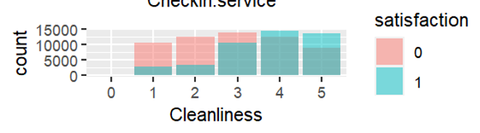
Progress and Challenges
Data cleaning status
Missing values removed
Investigating values with a Z-score > 3
Manually one-hot encoding data to establish baselines
Initial findings
Flight distance is not statistically significant
Business class is more likely to be satisfied
Some ratings seem irrelevant to customer satisfaction
Will not be able to merge flight path data to try to infer airport locations due to insufficient information:
Main dataset does not specify number of legs in a trip
Flight distances in main dataset are too similar in many instances which would make it impossible to narrow down with any certainty which airports were involved in the trip
Understanding how to map a binary satisfaction variable to a Likert scale variable
American Customer Satisfaction Index (ACSI) Dataset seems to contradict some of the findings from the primary dataset³
Notes:
The data is already very clean, we have eliminated missing values and are investigating whether to exclude values with a z score > 3 as well as manually one-hot enconding the data to establish baselines.
We have found that flight distance is not statistically significant, directly contradicting our hypothesis. Business class is more likely to be satisfied. Some factors just need to be good enough, i.e. cleanliness once it’s clean enough it doesn’t seem to drive significant additional satisfaction.
Some of the challenges that we’re facings are that we will not be able to merge flight path data with our dataset due to missing information.
We need to better understand how to map a binary satisfaction variable to a Likert scale variable.
American Customer Satisfaction Index (ACSI) Dataset seems to contradict some of the findings from the primary dataset³ for instance age and Gender are statistically insignificant in the the ACSI, contradicting the Logistic Regression model on Kaggle data

Slide 7
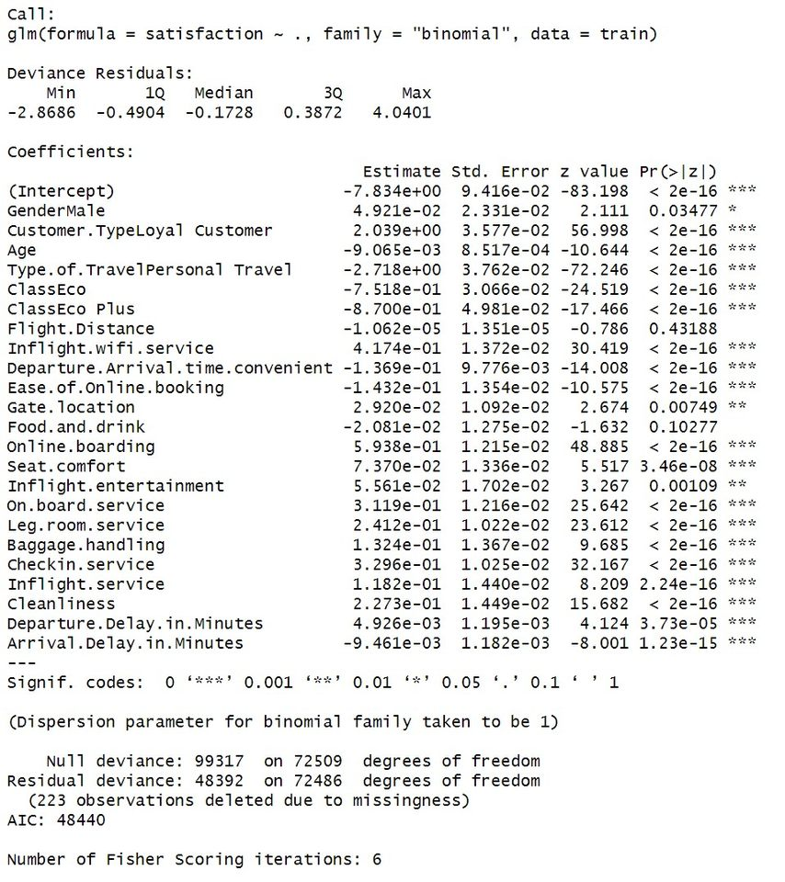
Modelling: First Pass Logistic Regression
Notes:
This is the output of our first pass logistic regression model without any transformations done on the data.
We thought that Flight Distance and Food and Drink would be important and this model shows them as statistically insignificant.

Slide 8
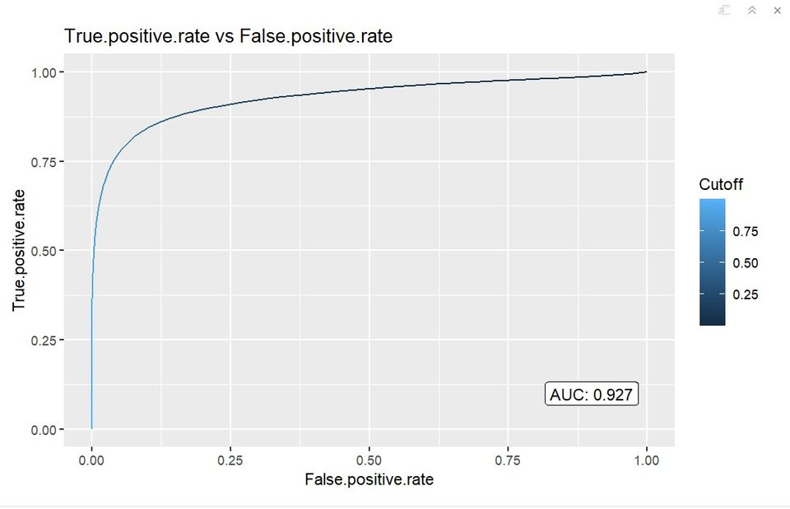
Modelling: First Pass Logistic Regression
Notes:
This is the ROC – Area Under the Curve for our first pass model. We achieved an AUC of 0.927.

Slide 9
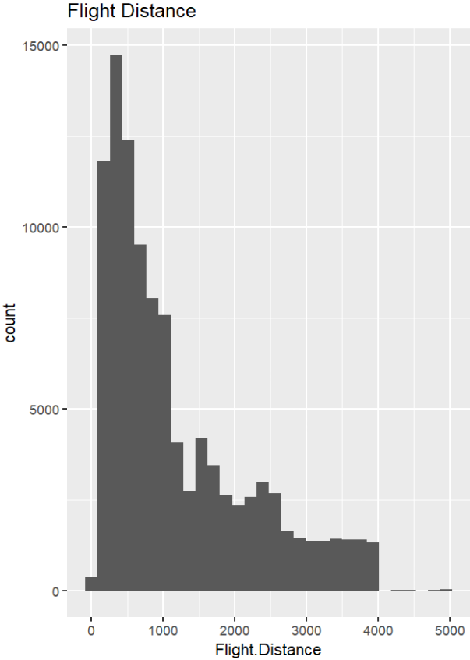
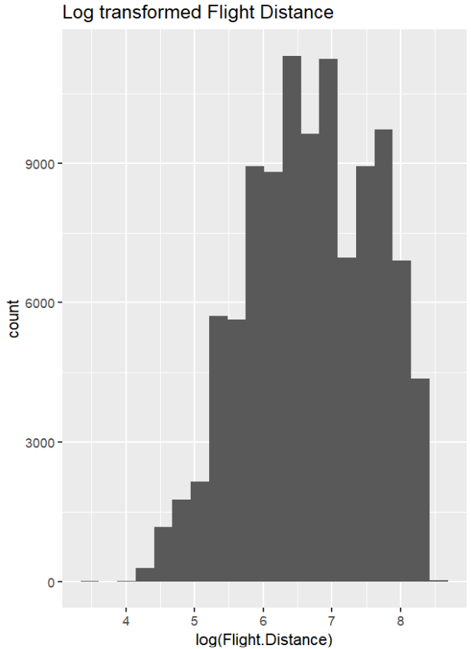
Transformations
Notes:
We’ve evaluated the distributions and most factors have a relatively normal distribution but some are heavily biased towards the low end such as flight distance as seen on the left picture. In this case, applying a log transformation helps normalize the distribution as shown on the right picture.

Slide 10
Modelling
Logistic Regression - Analysis of Distributions for possible transformations, Consider Regularization
Look at magnitude of coefficients
Compare results of transformed vs non-transformed data
Run diagnostics
Apply transformations as needed
Random Forest
Discover relative feature importance.
Support Vector Machines
Analysis of Distributions for possible transformations, Center and Scale Data, Optimal Choice of Kernel, Optimal Value of C/lambda.
The models will be compared using ROC-AUC on a reserved validation set.
Notes:
We have narrowed down the focus of our modeling to Logistic Regression, Random Forest, and Support Vector Machines.
We're going to test each variable using a logistic regression model one by one. We're going examine the distribution of the variable and the regression diagnostics to see if transformations or binning are required. If a log transform seems appropriate, we'll apply one and reiterate the prior steps. Otherwise, we'll examine the variable for binning. We'll compare the f-statistics of the transformations to the original logistic regression and make a decision as to whether it's an improvement. Then we'll move onto each variable and repeat. Once we have a suitable set of variables we'll run the full regression and check the f-statistic against the untransformed regression to assess whether there has been an overall improvement.
After we have what we believe to be our best logistic regression model, we'll cross validate it to get a measure of accuracy, as well as ROC auc. We'll repeat the crossvalidation process with SVM to see if it results in better accuracy and auc. We'll also use a random forests model to gauge relative feature importance.

Slide 11
Other Datasets and Research Findings
Pereira et al. (2023) provided an exhaustive and updated literature review about airlines’ passenger satisfaction while analyzing the most influential factors on satisfaction before and during the COVID-19 pandemic.³
Lucini et al. (2020) found practical implications to maximize customer satisfaction: focus on customer service for first class passengers, comfort for premium economy passengers, and checking luggage and waiting time for economy class travelers.⁴
Morgeson et al. (2023) focused on the American Customer Satisfaction Index (ACSI) and helped us better explore and analyze it.⁵
Notes:
Here is an overview of some research papers that we have found. Pereira analyzed customer satisfaction before and after the pandemic and noticed that some factors have become more important as a result of the pandemic, such as cleanliness.
Lucini found practical implications to maximize customer satisfaction:focus on customer service for first class passengers, comfort for premium economy passengers, and checking luggage and waiting time for economy class travelers
Morgeson et al. (2023) focused on the (ACSI) and helped us better explore and analyze it.⁵

Slide 12
Sources
https://www.forbes.com/sites/forbesbusinesscouncil/2022/12/12/customer-retention-versus-customer-acquisition/?sh=3cef46fc1c7d
https://www.kaggle.com/datasets/teejmahal20/airline-passenger-satisfaction
https://www.sciencedirect.com/science/article/pii/S0969699723000844#bib20
https://www.sciencedirect.com/science/article/abs/pii/S0969699719302959
https://www.sciencedirect.com/science/article/pii/S2352340923002421
https://psycnet.apa.org/record/1989-10632-001
https://www.techscience.com/cmc/v75n1/51460/pdf

